Slide 1
Citations Document
Maddy Wilcox
Fantasy Landscape

Slide 2
Instructions
Make a copy of this document in your own google drive
Fill in your name and the name of the class project
Fill in each slide as instructed. Replace any red text with your own text.
When you are ready to submit an assignment, download this completed document as a .pdf and upload it along with your art submission in Brightspace.

Slide 3
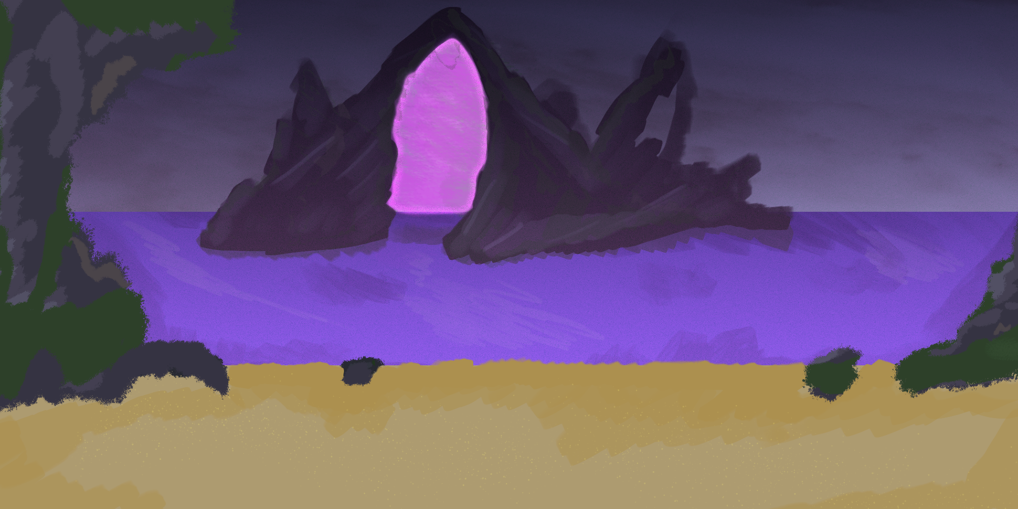
Final Artwork

Slide 4
Citations
Title of artwork or tutorial: Landscape Digital Painting for Beginners
Artist name: David Belliveau
Link: https://youtu.be/Zi-1e3ozFbU?si=dxqyN6QP_XGNNWVw
Use: Used for inspiration for drawing and techniques
Title of artwork or tutorial: How to Paint a MOUNTAIN - in Photoshop
Artist name: Olof Storm
Link: https://youtu.be/u_L9ZnpUYBM?si=OH4BV4k-NuRUH3nS
Use: Used for more information on making mountains in Photoshop
Title of artwork or tutorial: How to Paint a MOUNTAIN - in Photoshop
Artist name: Emily's Art Studio
Link: https://www.youtube.com/watch?v=wnpT6rMjhBo
Use: Used for more information on drawing beaches in Photoshop

Slide 5
AI Disclosure
Were any AI tools or workflows used in the creation of this work? If so, describe the tool, how it was used, and if applicable, provide a screenshot of what was generated using the tool.
No AI tools were used in making this.

Slide 6
Use of resources
Were any parts of the final image traced from a photo, or using a photo as a texture? If so make sure to include citation slides for these as well.
Photoshop Brush Pack - https://www.deviantart.com/rav89/art/brushes-for-photoshop-750331648

Slide 7
Creative Process
I’m fairly new to Photoshop and extremely new to painting so for this piece I tried to use more techniques and tools that I have never used. First where I typically use just two or three layers I ended up with 7. I found that this really helped me stay more organized and it helped a lot when I needed to go back and add something to a layer but have it go under or over something else. I also did a bit more research and found some new brushes which helped with some small parts like foliage and the texture of the mountains. I started with blocking out the sand, sky, and water. After that I added the mountains on a new layer on top and then tried to add shading and texturing using different shades. After that I created a “haze” layer to try to add some depth to the background mountains and added them in.

