Slide 1
Citations Document
Maddy Wilcox
Independent Work 3

Slide 2
Instructions
Make a copy of this document in your own google drive
Fill in your name and the name of the class project
Fill in each slide as instructed. Replace any red text with your own text.
When you are ready to submit an assignment, download this completed document as a .pdf and upload it along with your art submission in Brightspace.

Slide 3
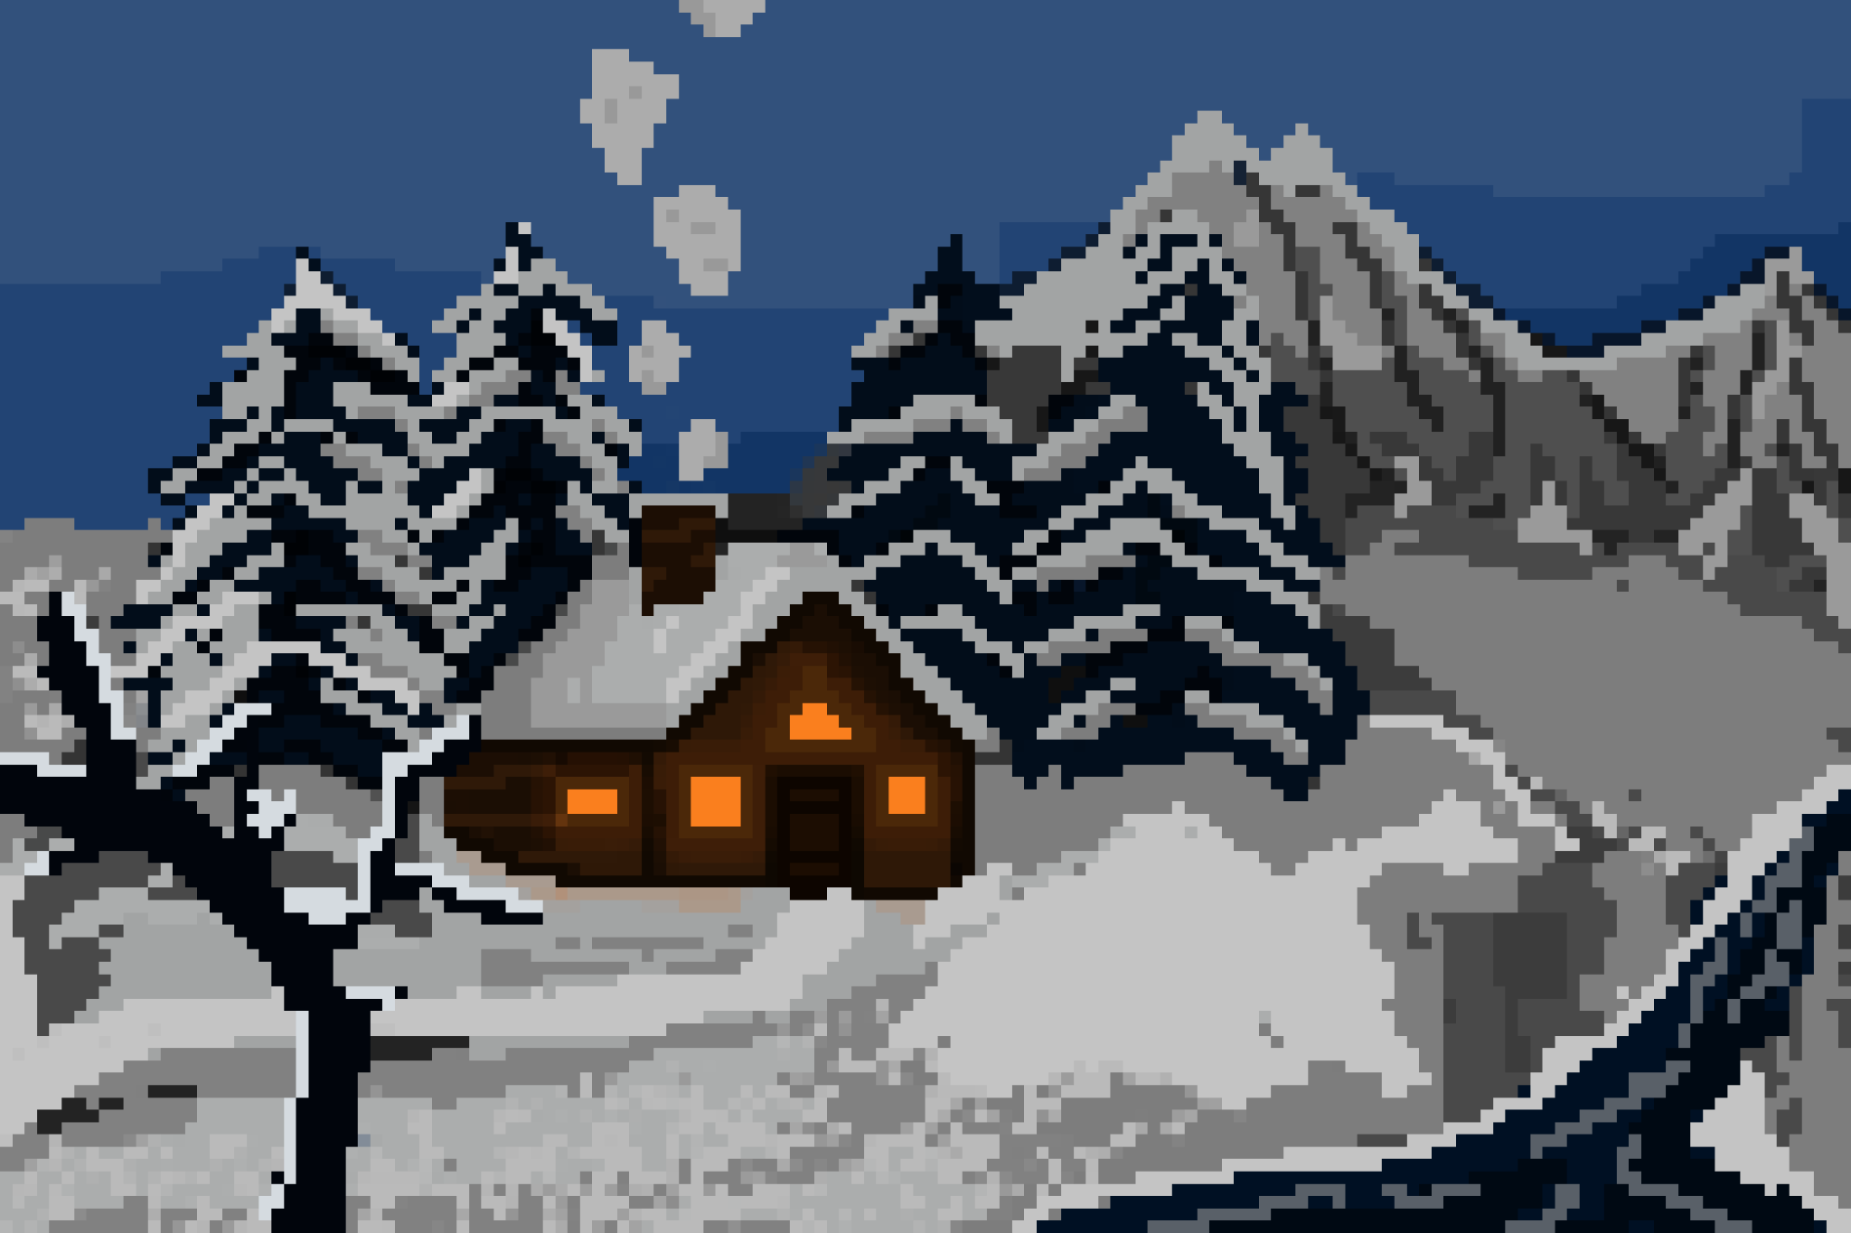
Final Artwork

Slide 4
AI Disclosure
Were any AI tools or workflows used in the creation of this work? If so, describe the tool, how it was used, and if applicable, provide a screenshot of what was generated using the tool.
No AI tools were used in making this.

Slide 5
Use of resources
Title: Snowy landscape
URL: https://youtu.be/daWxl0UV8YE
Artist: MarcoValeKaz
Use: Used to gain insights into how to draw pixel art
Title: Pixel Brushes in Photoshop
URL: https://youtu.be/DfTA7sktFJU
Artist: MarcoValeKaz
Use: Used for information on how to set up brushes for pixel art

Slide 6
Creative Process
For this piece I wanted to try something that I had never done before which is pixel art. I started with a background and a very rough sketch that I refined to get the shapes of the object down. From there I added rough colors and then went back and added more shades. Finally I added some smaller details and blended colors where I though there were too big of jumps.

